Slide 1
Dog shelter presentation
Made by: Tóth róbert, ács norbert, szentpáli richárd

Slide 2
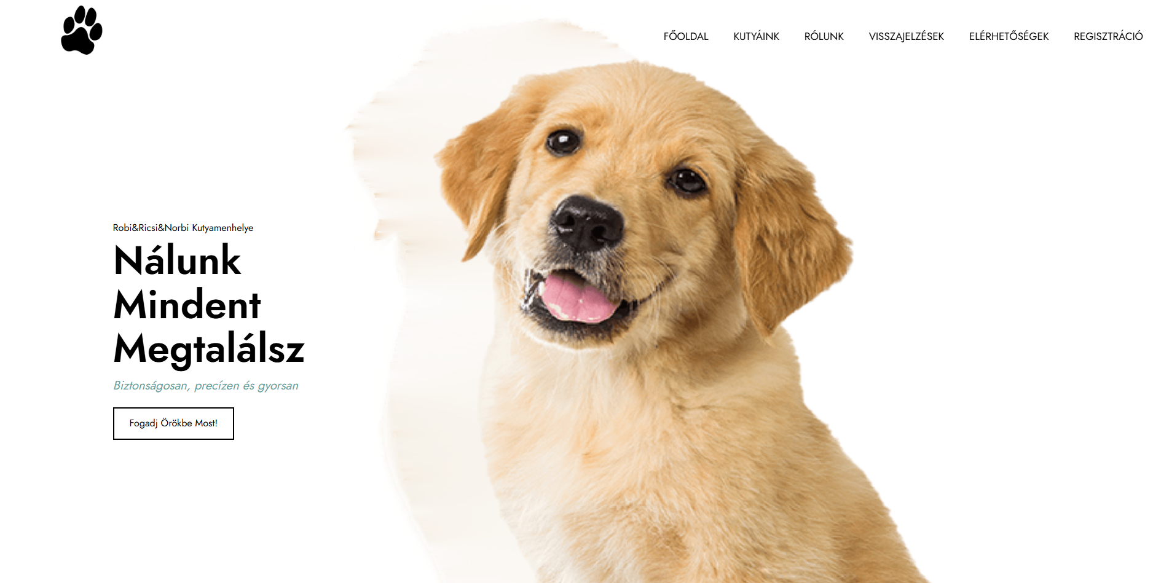
What is this site about...
Notes:
At our shelter, many dogs wait for a new home. You can find puppies from 8–10 weeks old and dogs up to 10 years. At our shelter, you can not only adopt dogs, but also upload dogs who need a new home.
Adoption is easy:
Choose your dog online with a few clicks
Call us to agree on the details
You can come the next day and take your dog home
Give a dog the loving home it dreams of!

Slide 3
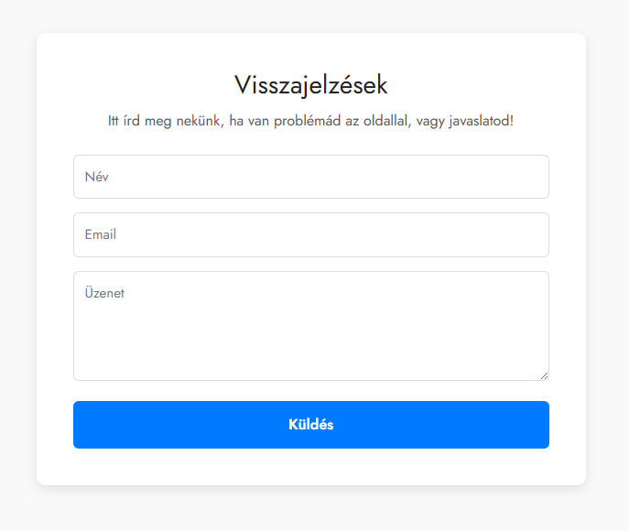
Feedback
Feedback and questions: You can send feedback or a question on our website. When we answer, you will get an email message.

Slide 4
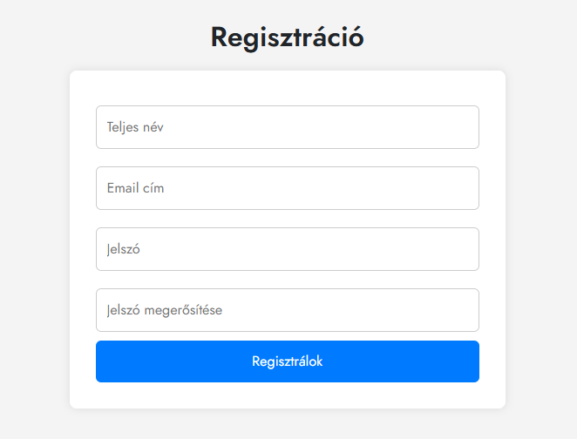
Login and Registration
You can create a new account.
If you have an account, you can log in.
With your account, you can see your dogs, your feedback, and your adoption requests.

